Slide 1
Patient Decision Aid for Cardiopulmonary resuscitation and invasive mechanical ventilation
This decision aid was developed in collaboration with:
And with the help of patients admitted to the Intensive Care Unit of the Hôtel-Dieu de Lévis hospital and their family members.
Intended for capable patients admitted to the Intensive Care Unit of the Hôtel-Dieu de Lévis hospital
Updated February, 21st, 2016

Slide 2
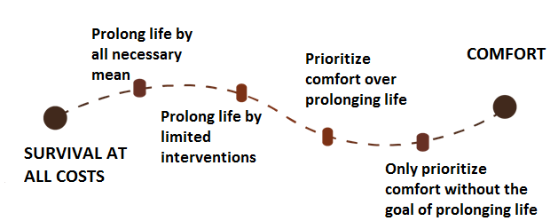
Introduction
What happens after this conversation?
Once admitted to the intensive care unit, it is important to clarify your goals of care to ensure that the interventions offered to you are in line health and your wishes.
There are four different goals of care :
This document was created to help prepare you to have a discussion with your physician. In particular, you will discuss your wishes, current and anticipated levels of independence and two interventions: :
1: Cardiopulmonary Resuscitation (or CPR)
2:Invasive mechanical ventilation (being connected to a breathing machine)
Your goals of care will be added to your medical chart and your treatment plan will be adjusted, accordingly.
You can always change your mind. Just let a team member know.
If you have any questions or concerns about the information provided in this decision aid, please feel free to discuss your concerns with your care team.
2
11

Slide 3
Summary
Your wishes and current and anticipated levels of independence
This document presented you with two interventions. You reflected on your wishes and your current and anticipated levels of independence.
For now, if your heart stops beating, would you like your care team to attempt CPR?
Yes No Undecided
If necessary, would you want to be kept alive with invasive mechanical ventilation?
Yes No Undecided
Notes
Below are a few questions to help your care team get to know you:
Do you know anyone who has experienced CPR or invasive mechanical ventilation ?
What are your wishes when it comes to CPR and invasive mechanical ventilation?
10
3

Slide 4
What are the benefits and the risks of Invasive Mechanical Ventilation?
Before your current hospitalization, how did you complete your day-to-day activities? (Check all that apply)
If your condition necessitates the use of invasive mechanical ventilation, you can still die whether or not you accept this intervention. If you accept invasive mechanical ventilation, the chances of surviving are higher, but the sIde effects are also higher.
 | ✔
without help?
with an assisting device? (ex: a cane, a walker)
with adaptation? (ex: wheelchair ramps)
with human help? (ex: help from a family member, home health aide)
BENEFITS | RISKS
Can avoid sudden death | Complications (ex: pneumonia)
Can possibly regain former level of independence and leave the hospital | Emotional and physical suffering
If you lose your independence after this hospitalization, would you accept to live: (check all that apply)
 | ✔
at home with help?
in a long-term care facility for semi-independent persons?
in a long-term care facility for non-independent persons?
If you refuse invasive mechanical ventilation, other less aggressive and less effective therapies could be offered to you.
If invasive mechanical ventilation or other less aggressive and less effective therapies were to fail, you would be offered palliative care.
4
9

Slide 5
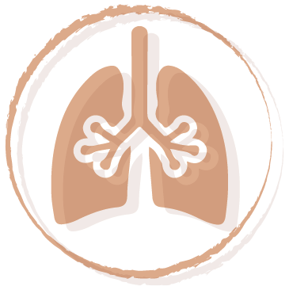
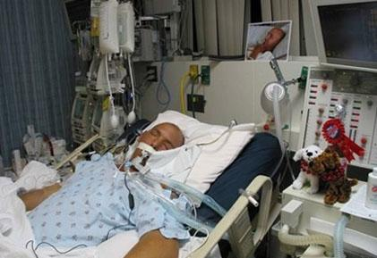
Intervention #2 Invasive Mechanical Ventilation
When would prolonging your life become unacceptable? (you can choose all that apply)
Invasive mechanical ventilation takes place with the help of a machine that artificially reproduces natural breathing. The machine pushes oxygen into the lungs through a breathing tube installed through the month into the lungs.
Invasive mechanical ventilation does not, in-and-of-itself, heal the primary health condition.
It keeps the patient alive so that the carel team can try and address the primary condition. During invasive mechanical ventilation, care team administers medication to the patient to reduce their discomfort. During invasive mechanical ventilation, patients cannot eat or speak normally.
 | ✔
If I were no longer able to communicate with others
If I were no longer able to control of my personal care
If I were bedridden but still able to communicate with others
Before reading this document, had you already thought about :
 | yes | no
your wishes to accept or not CPR and/or invasive mechanical ventilation
the factors that would make prolonging your life unacceptable?
Have you written these wishes somewhere?
(ex: a living will)
8
5

Slide 6
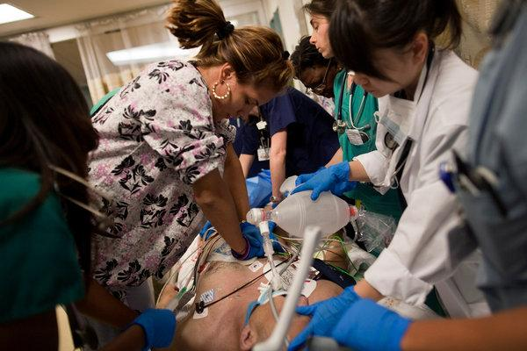
Intervention #1 Cardiopulmonary Resuscitation (CPR)
What are the benefits and the risks of Cardiopulmonary Resuscitation (CPR)?
Cardiopulmonary resuscitation (CPR) is a group of interventions used to try and restart the heart of an individual that has stopped beating.
When CPR is performed in a hospital :
1. Blood circulation is maintained by a cardiac massage
2.A tube is inserted in the mouth to assist breathing (intubation and invasive mechanical ventilation)
3. Electric shocks (defibrillation) can be used
4.Medication is administered
If a person’s heart stops beating and nothing is done, the person dies a painless death. If CPR is attempted, the individual has between 0 to 30% chance of survival, depending on their medical condition₁.
BENEFITS | RISKS
Can avoid a sudden death | Brain injury
Can possible regain former level of independence and leave the hospital | Fractured ribs
Your physician will be able to explain your chance of survival and your anticipated level of independence following CPR.
¹ Ebell et al., 2014 et Canadian Researchers at the End-of-Life Network
6
7

