Slide 1
Patient Decision Aid:
Sharing Goals for ICU care
This decision aid was developed with patients and family members at Hôtel-Dieu de Lévis ICU
For patients and families in the Intensive Care Unit (ICU)
Updated February, 22nd, 2017

Slide 2
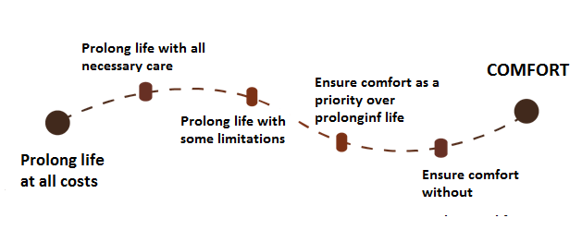
Introduction
What happens after this conversation?
In the ICU, it is important that we understand your goals of care to ensure that the care we provide meets your health needs and respects your wishes.
There are four different goals of care :
Your physician will meet you to discuss your wishes, current and anticipated levels of independence. Together, you will make a decision about ICU Care, including:
1: Cardiopulmonary Resuscitation (or CPR)
2:Invasive mechanical ventilation (being connected to a breathing machine)
Your goals of care will be added to your chart and your team will work with you to plan your care.
When treatments such as invasive mechanical ventilation or CPR cannot prolong life or are not wanted, you will continue to receive the best care.
You can always change your mind. Just let a team member know.
2
11

Slide 3
Summary
Your wishes and current and anticipated levels of independence
This document presented you with information about two ICU interventions. You reflected on your wishes and your current and anticipated levels of independence.
For now, if your heart stops beating, would you like your care team to attempt CPR?
Yes No Undecided
For now, if you can’t breath without help, do you want invasive mechanical ventilation?
Yes No Undecided
Notes
Below are a few questions to help your care team get to know you:
Do you know anyone who has had CPR or invasive mechanical ventilation ?
What are your wishes when it comes to CPR and invasive mechanical ventilation?
10
3

Slide 4
What are the benefits and the risks of Invasive Mechanical Ventilation?
Before your current hospitalization, how did you complete your day-to-day activities? (Check all that apply)
People kept alive with invasive mechanical ventilation can still die from their illness. While the chances of surviving are higher, some survivors live with important side effects.
 | ✔
without help?
with an assisting device? (ex: a cane, a walker)
with adaptation? (ex: wheelchair ramps)
with human help? (ex: help from a family member))
BENEFITS | RISKS
Can avoid sudden death | Complications (ex: pneumonia)
Can possibly regain former level of independence and leave the hospital | Emotional and physical suffering
If you lost your independence after this hospitalization, where would you be willing to live? (check all that apply)
 | ✔
at home with help?
in a long-term care facility for semi-independent persons?
in a long-term care facility for non-independent persons?
If invasive mechanical ventilation cannot prolong life or is not wanted, other less aggressive and less effective therapies could be offered to you. If these therapies cannot prolong life or are not wanted, you will continue to receive care to relieve suffering and pain (palliative care).
4
9

Slide 5
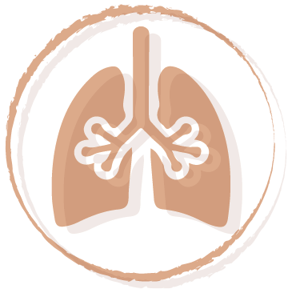
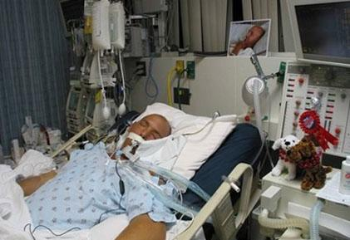
Intervention #2 Invasive Mechanical Ventilation
When would prolonging your life become unacceptable? (you can choose all that apply)
Invasive mechanical ventilation is a machine that pushes air into the lungs through a tube in the month or neck. This is also known as “being kept on life support”.
Invasive mechanical ventilation does not heal breathing problem. It keeps the patient alive so that the care team can address the breathing problem. During invasive mechanical ventilation, nurses administer medication to the patient to reduce their discomfort. When a patient is mechanically ventilated, they cannot eat or speak.
.
 | ✔
If I could not communicate with others
If I needed help with personal care
If I were bedridden
Had you made a decision before reading this document :
 | yes | no
about CPR ?
about invasive mechanical ventilation?
about when prolonging your life would be unacceptable?
Have you written these wishes somewhere?
(ex: a living will)
8
5

Slide 6
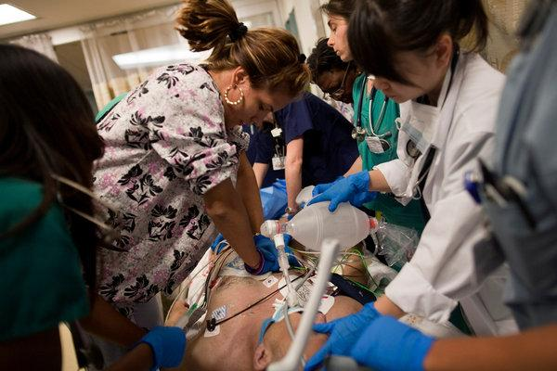
Intervention #1 Cardiopulmonary Resuscitation (CPR)
What are the benefits and the risks of Cardiopulmonary Resuscitation (CPR)?
Cardiopulmonary resuscitation (CPR) is a group of interventions used to try and restart the heart when it stops beating.
When CPR is performed in a hospital :
1. Blood circulation is maintained by pressing on the chest
2.A tube is inserted in the lungs through the mouth to assist breathing (intubation and invasive mechanical ventilation)
3. Electric shocks (defibrillation) can be used
4.Medication is administered
If a person’s heart stops beating and nothing is done, the person dies. CPR can provide between 0 to 30% chance of survival, depending on their medical condition₁.
BENEFITS | RISKS
Can avoid a sudden death | Brain injury
Can possible regain former level of independence and leave the hospital | Fractured ribs
Your physician will be able to explain your chance of survival and your anticipated level of independence following CPR.
¹ Ebell et al., 2014 et Canadian Researchers at the End-of-Life Network
6
7

